Slide 1
Data Structures and Algorithms
CSC 206
Unit 4: Lists
Shyam Sunder Khatiwada

Slide 2
List
List is a sequential data structure in which addition and removal of data items can be done from any position.
List is a collection of nodes.
The list is an
Ordered sequence of data items called elements
A1, A2, A3,.......A_{N} is a list of size N
size of an empty list is 0
A_{i+1} succeeds A_{i}
First element is A₁ is called “head”
Last element is A_{N} called “tail”

Slide 3
List Operation
Add: add a new node
Set: Update the contents of a node
Remove: remove a node
IsEmpty: reports whether the list is empty
IsFull: reports whether the list is full
Initialize: creates/initializes the list
Destroy: deletes the contents of the list.

Slide 4
List Operation
initialize(L)
creates a new empty List named L
add(1,X,L)
add the value X to list at position 1 (the start of the list is position 0), shifting subsequent elements up
set(2,Z,L)
updates the value at position 2 to be Z
remove(Z,L)
removes the node with value Z
get(2,L)
returns the value of the third node i.e. C
indexOf(X,L)
returns the index of the node with value X, i.e. 1

Slide 5
Static List Structure
Static implementation of list stores the items in an array. The position of elements is given by an index starting with 0 to n-1, where n is the number of elements.
Static list is of fixed size. The different operations within the static list and their complexities are as follows:
Given an index, the element at that position can be accessed at constant time, without any relation with the size of list.
To add an element at the end of the list, it can also be done at constant time, to add an element at any other position involves shifting up one position of all the subsequent elements, so the time complexity depends on the size of the list.
To remove an element from the list, all the subsequent elements should be shifted down one position, so the time complexity depends on the size of the list.

Slide 6
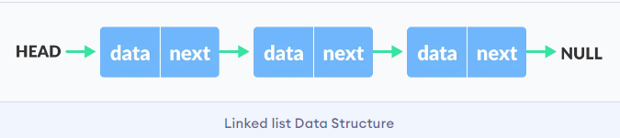
Dynamic List Structure
In Dynamic data structure the size of the structure is not fixed and can be modified during the operations performed on it.
Dynamic data structures are designed to facilitate change of data structures in the run time.
Example of Dynamic Data structures: Linked List

Slide 7
Array Implementation of List
Suppose a list of fixed size N i.e. index ranges from 0 to N-1.
Insertion of Node at kth Position
If (k>=N):
Display “List index out of range”
Else:
Initialize i=N-1
list[i]=list[i-1]
Decrement by 1
if(i==k):
list[i]=item
Else:
Repeat from step 2(b)
stop
Deletion of Node at kth position
if(k>=N):
Display “List index out of range”
Else:
Initialize i=k
list[i]=list[i+1]
Increment i by
Repeat until i>=N-1
Stop

Slide 8
Workout
Write a program to implement the list using an array.

Slide 9
Array implementation of List
Advantages of Array Implementation
variables are stored in contiguous memory.
Easy to handle data
Limitations of Array Implementation
Hard to add/remove elements
Can not be dynamically resized
Memory loss

Slide 10
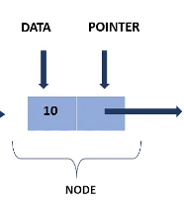
Linked List
A linked list is a linear collection of data elements, called nodes, where the linear order is given by means of pointers.
Each node is divided into two parts:
The first part contains the information of the element and
The second part contains the address of the next node(link/next pointer field) in the list.

Slide 11
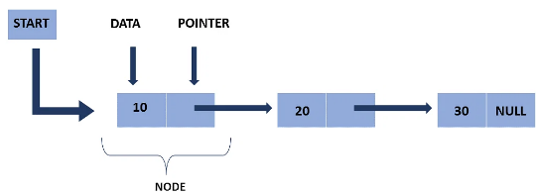
Linked List Representation
Linked list can be visualized as chain of nodes, where every node points to the next node.
The first node is called head. If the linked is empty, then value of head is NULL.
As per the illustration, following are the important points to be considered.
Linked List contains a linked element called first.
Each link carries a data field(s) and a link field called next.
Each link is linked with its next link using its next link.
Last link carries a link as null to mark the end of the list.

Slide 12
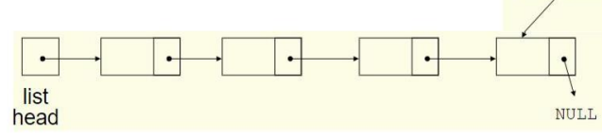
Linked List
Data structures can be added to or removed from the linked list during execution NULL list head newNode
new Node

Slide 13

Linked List
Linked lists can grow and shrink as needed, unlike arrays, which have a fixed size linked lists can insert a node between other nodes easily NULL list head

Slide 14
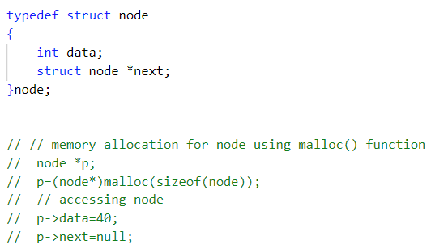
Implementation of Linked List
Structure is used to define a node. Node is collection of Data and Address of Next Node can be stored in pointer type variable.
It is self referential structure in C.
It is Assumed that, type of data stored in each node is of integer type.
In C programming, memory can be acquired through use of standard library functions malloc() and calloc() from stdlib.h header file.
To Free Memory acquired, free(address) function is used.
40 | null

Slide 15
Why use linked list over array?
Arrays can be used to store linear data of similar types, but arrays have following limitations.
Array contains following limitations:
The size of array must be known in advance before using it in the program.
Increasing size of the array is time taking process. It is almost impossible to expand the size of the array at run time.
All the elements in the array need to be contiguously stored in the memory. Inserting any element in the array needs shifting of all its predecessors.

Slide 16
Why use linked list over array?
For example, in a system if we maintain a sorted list of IDs in an array id[].
id[] = [1000,1010,1020,1030,1040]
And if we want to insert a new ID 1050, then to maintain the sorted order, we have to move all the elements after 1000(excluding 1000).
Deletions is also expensive with arrays until unless some special techniques are used.
For example, to delete 1010 in id[], everything after 1010 has to be moved.

Slide 17
Why use linked list over array?
Linked list is the data structure which can overcome all the limitations of an array.
Advantage of linked list is that:
It allocates the memory dynamically. All the nodes of linked list are non contiguously stored in the memory and linked together with the help of pointers.
Sizing is no longer a problem since we do not need to define its size at the time of declaration. List grows as per the program’s demand and limited to the available memory space.

Slide 18
Drawbacks of Linked List:
Though it overcomes all the limitations of an array, it has some drawbacks:
Random access is not allowed. we have to access elements sequentially starting from the first node. so we cannot do binary search with linked lists.
Extra memory space for a pointer is required with each element of the list.

Slide 19
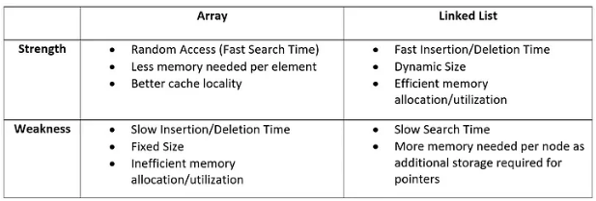
Array vs Linked List

Slide 20
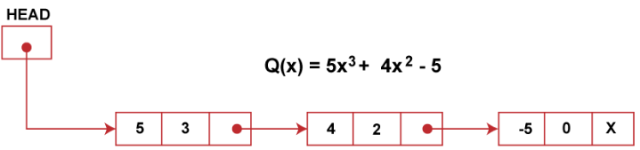
Application of Linked List
Linked list are frequently used to implement other data structures like tree, graphs and heaps.
Linked can be used to create dynamic stack and queue which can grow and shrink at runtime.
Linked list can used to store and process the polynomials.
Coefficient and power stored as data and link pointer points to next term in the polynomial.
Linked list are normally implemented using pointers. some languages does not support pointers like VB, Fortran etc. In these array is used to implement LL.

Slide 21
Operation of Linked List
We can treat linked list as an abstract data type and perform following basic operations.
Creating Linked List
Traversing Linked List
Displaying Linked List
Counting number of Nodes in Linked List
Searching an element in Linked List
Concatenating two Linked List
Inserting element into Linked List (Start, end and Specific Position)
Deleting elements from Linked List(Start, end and specific position)

Slide 22
Creating Linked List
Linked List is Created using Dynamic Memory Allocation
Create function is used to create the linked list. It return address of memory block reserved with size node to main function.
Variable HEAD, head, p are having storage class as node *. It can store address of node that has been created dynamically.
sizeof(node) indicates storage requirement to store a node.
malloc(sizeof(node)) returns the address of allocated memory block and it is assigned to variable head.
If head ==NULL, it means memory block not reserved hence linked list empty.
Type casting operator (node *) used before malloc tells memory block of size of node.

Slide 23
creating Node using Structure
node *create(int n) {
node *p, *head;
int i;
// first node
head = (node*)malloc(sizeof(node));
head->next=NULL;
printf(“\n \t Enter Data:”);
scanf(“%d”,&head-> data));
p=head;
// remaining nodes
for(i=1;i<n;i++)
{
p->next=(node*)malloc(sizeof(node));
p=p->next;
printf(“\n \t Enter Data %d:”,i+1);
scanf(“%d”,&(p->data));
p->next=NULL;
}
return head;
}
typedef struct node {
int data;
struct node* next;
}node;
node *create(int n);

Slide 24
Linked List Main Function:
void main(){
int n,i;
node *HEAD;
HEAD->next=NULL;
printf(“\n\t no of items:”);
scanf(“%d”,&n);
HEAD=create(n);
printf(“\n\t LLCreated from Address:%u”,HEAD);
}

Slide 25
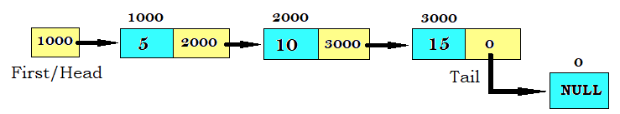
Traversing Linked List
Traversal of Linked list always starts with First Node.
Initially pointer type variable is assigned to First Node(HEAD).
In order to travel linked list in the forward direction, pointer is traversed through all the nodes.
Stop at node where address for next gets as NULL.
p=HEAD;
while(p!=NULL)
p=p->next;

Slide 26
Counting number of nodes Linked List
Take 1 variable, initialize to 0 (count=0)
Traverse the linked list from start node to last node and for each node do count++.
int count(node *p)
{
int count=0;
while(p!=NULL)
{
count=count +1;
p=p->next;
}
return count;
}

Slide 27
Display all nodes from list
Traverse the linked list from start node to last node and print each node.
Below function traverse entire linked list and while traversing it prints integer data stored in the node.
void display(node *p)
{
while(p!=NULL){
printf(“%d”,p-> data);
p=p->next;
}
}

Slide 28
Searching nodes from list
In order to search an element in Linked list, we start traversing from the first node.
Traversal ends with success if element found (1), if not it ends with failure (0).
Below function search the entire linked list for specific element, if it is found it returns 1 else 0.
int search(node *p, int x){
while(p!=NULL){
if(p->data==x)
return 1;
}

Slide 29
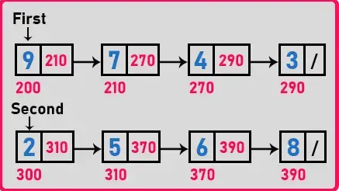
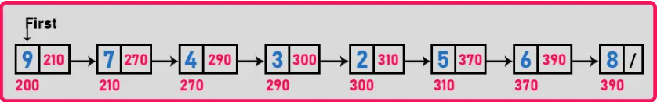
Concatenating two linked lists

Slide 30
Concatenating two linked lists
Let’s assume 2 linked list with 2 different heads- HEAD1 and HEAD2
If first linked list is empty, return HEAD1
Store the address of HEAD1 in pointer variable, say p.
Start Traversing first linked list and go to last node whose address field is NULL and Replace that NULL as HEAD2.
Return HEAD1

Slide 31
Code:Concatenating two linked lists
node *concatenate(node *head1, node *head2){
node *p;
if(HEAD1==NULL)
return HEAD2;
if(HEAD2==NULL)
return HEAD1;
while(p!=NULL){
p=p->next;
p->next=HEAD2;
}
return HEAD1;
}

Slide 32
Types of Linked List
Singly linked list
Doubly linked list
Circular linked list
Singly circular linked list
Doubly circular linked list

Slide 33
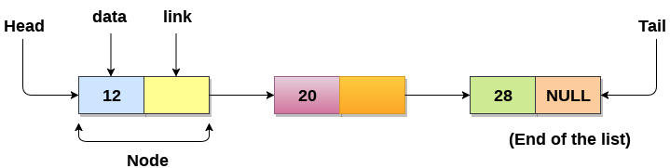
Singly Linked List
In any single linked list, the individual element is called as “Node”. Every “Node” contains two fields, data and next. The data field is used to store actual value of that node and next field is used to store the address of the next node in the sequence.
In this type of linked list, only one link in each node, where the link points to the next node in the list. The link of last node has a NULL pointer.
The graphical representation of a node in a single linked list is:

Slide 34
Representation of Singly Linked List
We can create a structure for the singly linked list - node, each node has two members, one is info that is used to store data items and another is next field that store the address of next node in the list.
we can define a node as follows:
struct Node{
int data;
struct node *next
}
typedef struct Node NodeType;
NodeType *head; // head is a pointer type structure variable

Slide 35
Operation of Singly Linked List
To create a new node, we use the malloc function to dynamically allocate memory for the new node.
After creating the node, we can store the new item in the node using a pointer to that node.
Steps required to create a node and storing an item:
Nodetype *p;
p=(NodeType*)malloc(sizeof(Nodetype));
p->info=50;
p->next=NULL;
Note: p is not a node; instead it is a pointer to a node.

Slide 36
Operation of Singly Linked List
The getNode function:
we can define a function getNode() to allocate the memory for a node dynamically. It is user-defined function that return a pointer to the newly created node.
Nodetype * getNode(){
NodeType *p;
p=(Nodetype*)malloc(sizeof(Nodetype));
return (p);
}
Creating the empty list:
void createEmptyList(Nodetype *head){
head=NULL;
}

Slide 37
Operation of Singly Linked List: Inserting node
Inserting Nodes:
To insert an element or a node in a linked list, the following three things to be done:
Allocating a node
Assigning a data to info field of the node
Adjusting a pointer and a new node may be inserted
In a linked list, the insertion operation can be performed in three ways. They are as follows…
Inserting At Begining of the list
Inserting At End of the list
Inserting At specific location in the list.

Slide 38
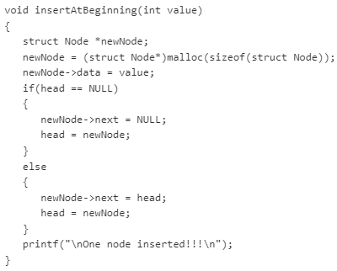
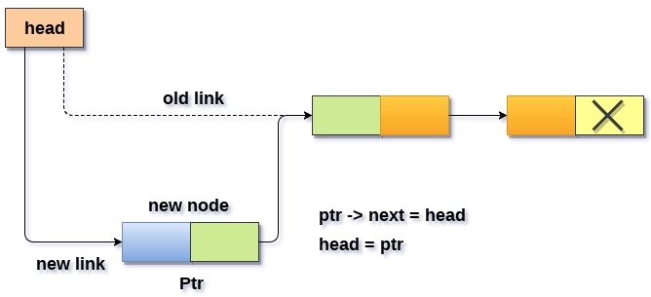
Operation of Singly Linked List: insertion at beginning
We can use the following steps to insert a new node at beginning of the single linked list..
create a newNode with given value.
check whether list is Empty (head= = NULL)
If it is Empty then, set newNode →next = NULL and head = newNode
If it is Not Empty then, set newNode →next = head and head = newNode

Slide 39
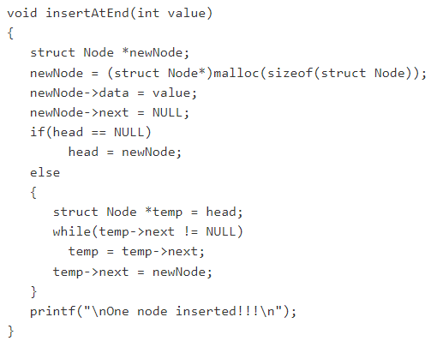
Operation of Singly Linked List:insertion at the end
We can use the following steps to insert a new node at the end of the single linked list…
create a newNode with given value and newNode → next as NULL.
Check whether list is Empty (head = = NULL).
If it is Empty then, set head = newNode.
If it is Not Empty then, define a node pointer temp and initalize with head.
Keep moving the temp to its next node until it reaches to the last node in the list (until temp → next is equal to NULL).
set temp → next = newNode.

Slide 40
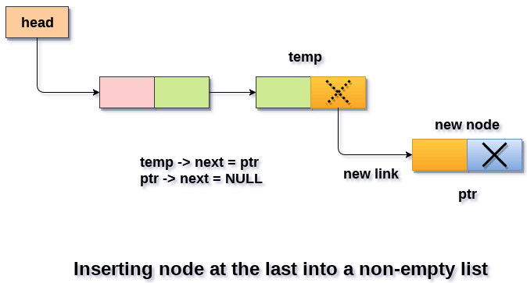
Operation of Singly Linked List:insertion at the end

Slide 41
Operation of Singly Linked List: insertion at specific location
We can use the following step to insert a new node after a node in the single linked list….
Create a newNode with given value.
Check whether list is Empty (head = = NULL).
If it is Empty then, set newNode→next = NULL and head = newNode.
If it is not Empty then, define a node pointer temp and initialize with head.
Keep moving the temp to its next node until it reaches to the node after which we want to insert the newNode(until temp1 → data is equal to location, here location is the node value after which we want to insert a newNode).
Every time check wheter temp is reached to last node or not. If it is reached to last node then display ‘Given node is not found in the list !!! Insertion not possible!!!’ and terminate the function, Otherwise move the temp to next node.
Finally, set ‘newNode → next = temp → next’ and ‘ temp → next = newNode’

Slide 42
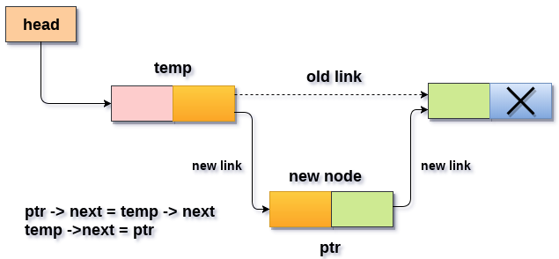
Singly: insertion at specific location
void insertAtSpecificPos(int value, int loc1)
{
struct Node *newNode;
newNode = (struct Node*)malloc(sizeof(struct Node));
newNode->data = value;
if(head == NULL)
{
newNode->next = NULL;
head = newNode;
}
else
{
struct Node *temp = head;
while(temp->data != loc1)
temp = temp->next;
newNode->next = temp->next;
temp->next = newNode;
}
printf("\nOne node inserted!!!\n");
}

Slide 43
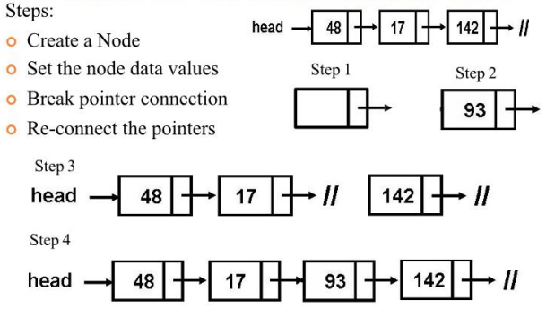
Insertion at specific location:

Slide 44
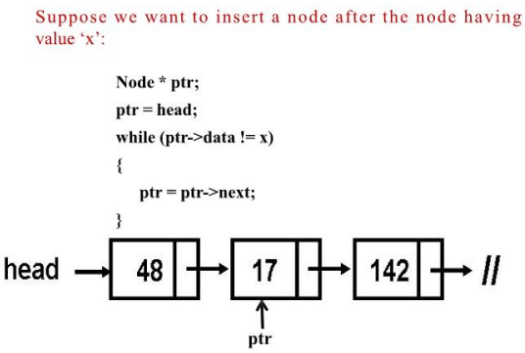
Insertion at specific location:

Slide 45
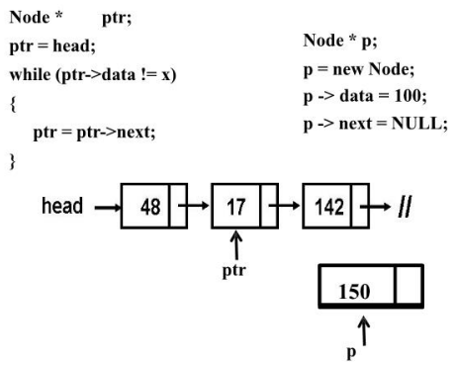
Insertion at specific location:

Slide 46
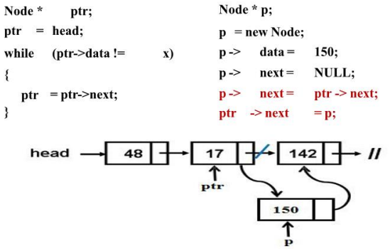
Insertion at specific location:

Slide 47
Operation of Singly Linked List: Deleting node
Deleting node:
To delete a node from linked list, we need to do following steps:
Find previous node of the node to be deleted.
change the next of previous node.
Free memory for the node to be deleted.
In a linked list, the deletion operation can be performed in three ways:
Deleting from Beginning of the list
Deleting from End of the list.
Deleting a Specific Node.

Slide 48
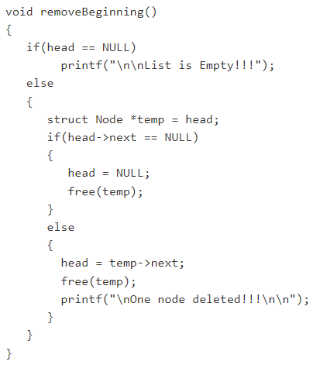
Deletion of node from Beginning of the list
Deletion : node from beginning of the list
Check whether list is Empty (head = = NULL)
If it is Empty then, display ‘List is Empty!!! Deletion is not possible’ and terminate the function.
If it is Not Empty then, define a Node pointer ‘temp’ and initalize with head.
Check whether list is having only one node (temp → next = = NULL).
If it is TRUE then set head = NULL and delete temp (Setting Empty list conditions)
If it is FALSE then set head = temp → next, and delete temp.

Slide 49
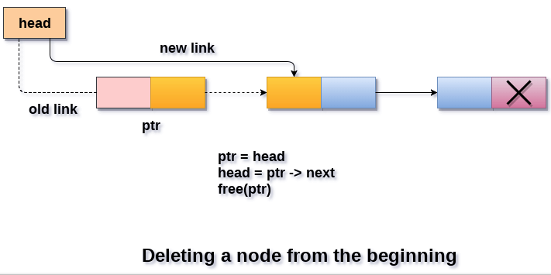
Deletion of node from Beginning of the list

Slide 50
Deletion of node from end of the list
Check whether list is Empty (head = = NULL)
If it is Empty then, display ‘LIst is Empty!!! Deletion is not possible’ and terminate the function.
If it is Not Empty then, define two Node pointers ‘temp1’ and ‘temp2’ and initialize ‘temp1’ with head.
Check whether list has only one Node (temp1 → next = = NULL)
If it is TRUE, Then, set head = NULL and delete temp1. And terminate the function. (Setting Empty list condition)
If it is FALSE. Then, set ‘temp2 = temp1’ and move temp1 to its next node. Repeat the same until it reaches to the last node in the list.(until temp1 → next = = NULL)
Finally, Set temp2 → next= NULL and delete temp1.

Slide 51
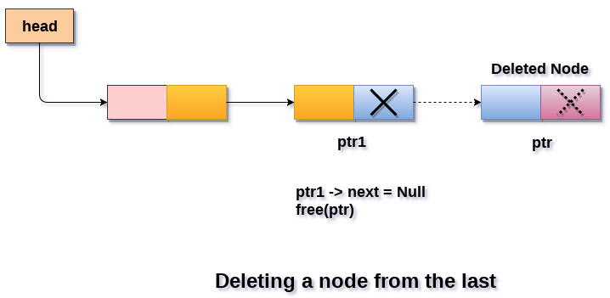
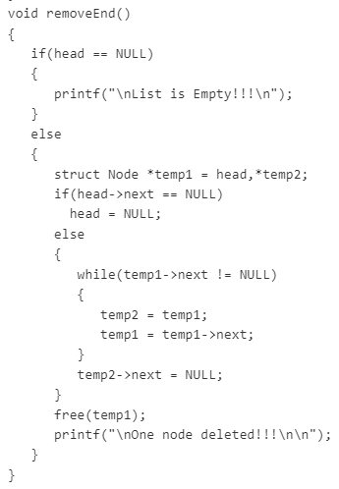
Deletion of node from end of the list

Slide 52
Deletion of specific node from Singly linked list.
Check whether list is Empty (head = = NULL)
If it is Empty then, display ‘List is Empty!!! Deletion is not possible’ and terminate the function.
If it is Not Empty then, define two NOde pointer ‘temp1’ and ‘temp2’ and initialize ‘temp1’ with head.
Keep moving the temp1 until it reaches to the exact node to be deleted or to the last node. And every time set ‘temp2 = temp1’ before moving the ‘temp1’ to its next node.
If it is reached to the last node then display ‘Given node not found in the list! Deletion not possible!!!’. And terminate the function.
6. If it is reached to the exact node which we want to delete, then check whether list is having one node or not.

Slide 53
Deletion of specific node from Singly linked list.
7. If list has only one node and that is the node to be deleted, then set head = NULL and delete temp1 (free(temp1)).
8. If list contains multiple nodes, then check whether temp1 is the first node in the list (temp1 == head).
9. If temp1 is the first node then move the head to the next node (head = head → next) and delete temp1.
10. If temp1 is not first node then check whether it is last node in the list (temp1 → next = NULL).
11. If temp1 is last node then set temp2→ next = NULL and delete temp1 (free(temp1)).
12. If temp1 is not first node and not last node then set temp2 → next = Temp1→ next and delete temp1 (free (temp1)).

Slide 54
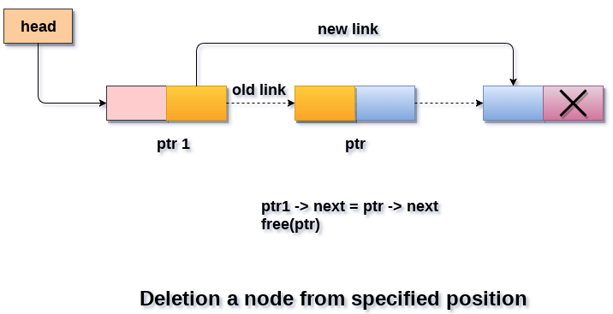
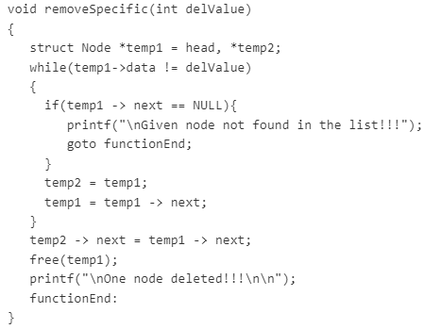
Deletion of specific node from Singly linked list.

Slide 55
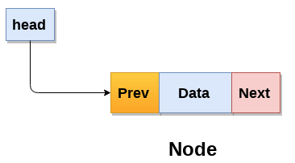
Doubly Linked List
Doubly Linked list is a complex type of linked list in which a node contains a pointer to the previous as well as the next node in the sequence.
Therefore, in a doubly linked list, a node consists of three parts:
node data
pointer to the next node in sequence (next pointer)
pointer to the previous node ( previous pointer)
Pointers exist between adjacent nodes in both directions. The list can be traversed either forward or backward.

Slide 56
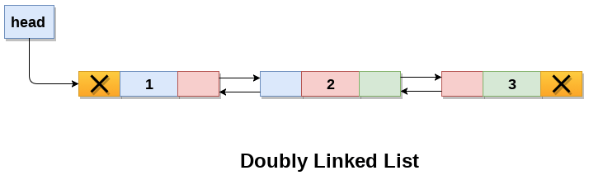
Doubly Linked List
A doubly linked list containing three nodes having numbers from 1 to 3.

Slide 57
Advantage of DLL over SLL
Advantages of DLL over SLL
A DLL can be traversed in both forward and backward direction.
The delete operation in DLL is more efficient if pointer to the node to be deleted is given.
In DLL, to delete a node, pointer to the previous node is needed. To get this previous node, sometimes the list is traversed. In DLL, we can get the previous node using previous pointer.
Disadvantages of DLL over SLL
Every node of DLL require extra space for an previous pointer.
All operations require an extra pointer perviouss to be maintained. For example, in insertion, we need to modify previous pointers together with next pointers.

Slide 58
Doubly Linked List: Representation
Node Representation-
typedef struct node{
int data;
struct node *prev;
struct node *next;
} dbnode;

Slide 59
Basic operation in Doubly linked list
Insertion
Insertion at the beginning of list.
Insertion at the end of the list.
Insertion at the specified position
Deletion
Deletion of first node.
Deletion of inner node.
Deletion of last node.
Traversing

Slide 60
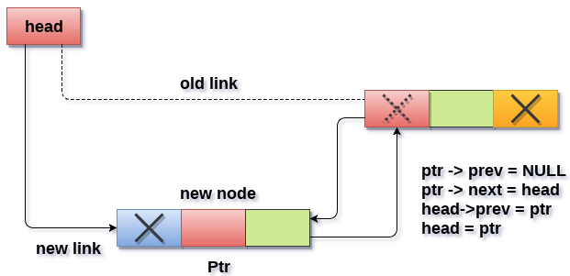
Doubly Linked List: Insertion at beginning of list
Create a newNode with given value and newNode → previous as NULL.
Check whether list is Empty (head = = NULL)
If it is Empty then, assign NULL to newNode → next and newNode to head.
If it is not Empty then, assign head to newNode → next and newNode to head.

Slide 61
Doubly Linked List: Insertion at specified position
Create a newNode with given value.
Check whether list is Empty (head = = NULL)
If it is Empty then, assign NULL to newNode → previous & newNode → next and newNode to head.
If it is not Empty then, define two node pointers temp1 and temp2 and initialize temp1 with head.
Keep moving the temp1 to its next node until it reaches to the node after which we want to insert the newNode (until temp1→ data is equal to location, here location is the node value after which we want to insert the newNode.
Every time check whether temp1 is reached to the last node. If it is reached to the last node then display ‘Given node is not found in the list!!! Insertion not possible!!!’ and terminate the function. Otherwise move the temp1 to next node.
Assign temp1 → next to temp2, newNode to temp1 → next, temp1 to newNode→ previous, temp2 to newNode → next and newNode to temp2 → previous.

Slide 62
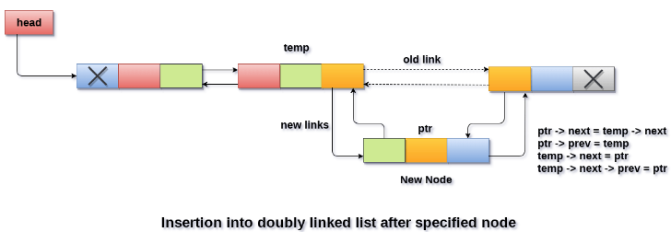
Doubly Linked List: Insertion at specified position

Slide 63
Doubly Linked List: Insertion at the end
Create a newNode with given value and newNode → next as NULL.
Check whether list is Empty (head = = NULL)
If it is Empty, then assign NULL to newNode → previous and newNode to head.
If it is not Empty, then define a node pointer temp and initialize with head.
Keep moving the temp to its next node until it reaches to the last node in the list (until temp → next is equal to NULL).
Assign newNode to temp → next and temp to newNode → previous.

Slide 64
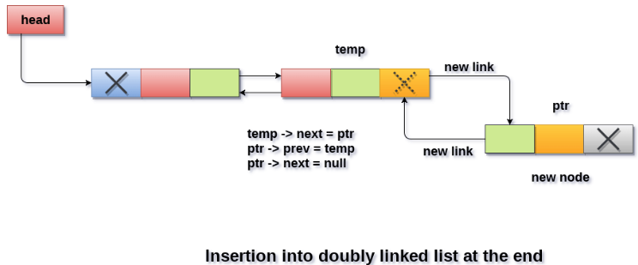
Doubly Linked List: Insertion at the end

Slide 65
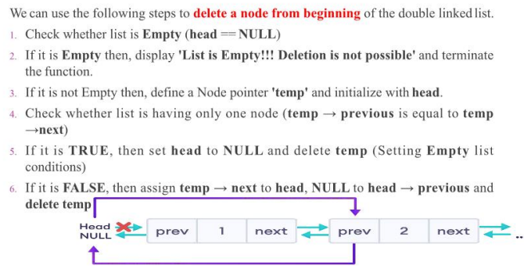
Doubly Linked List: Deletion of node from beginning

Slide 66
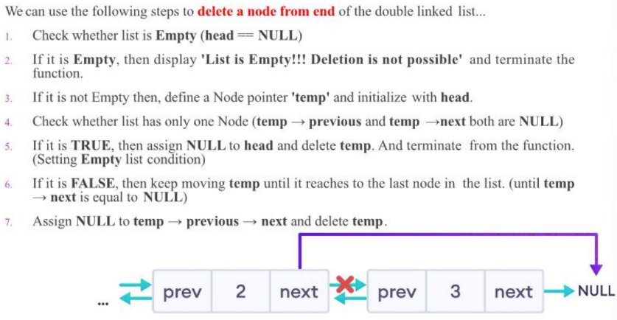
Doubly Linked List: Deletion from the end

Slide 67
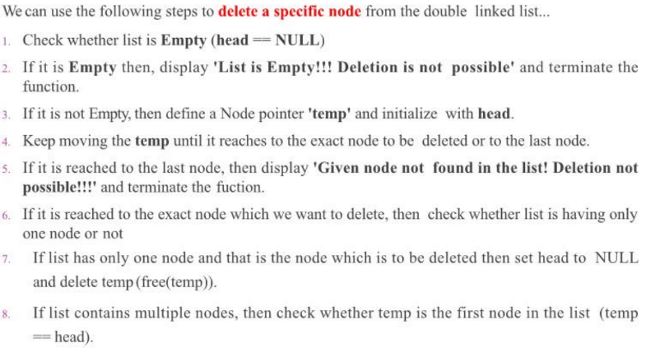
Doubly Linked List: Deletion of specific node

Slide 68
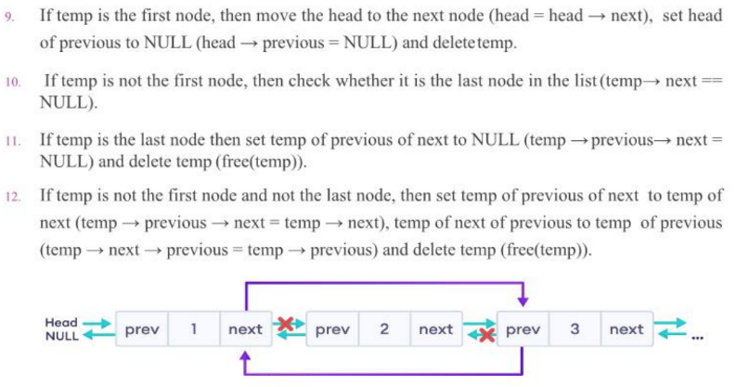
Doubly Linked List: Deletion of specific node

Slide 69
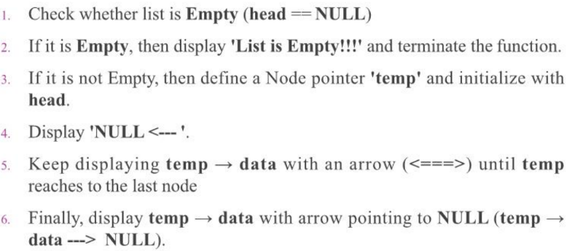
Doubly Linked List: Displaying elements

Slide 70
Doubly Linked List: Applications
Redo and undo functionality in software.
Forward and backward navigation in browsers.
For navigation systems where forward and backward navigation is required.

Slide 71
Circular Linked List:
A circular linked list is basically a linear linked list that may be :
single- or double-linked.
The only difference is that there is no any NULL value terminating the list.
In fact in the list every node points to the next node and last node points to the first node, thus forming a circle. Since it forms a circle with no end to stop it is called as circular linked list.
In circular linked list there can be no starting or ending node, whole node can be traversed from any node.
In order to traverse the circular linked list, only once we need to traverse entire list until the starting node is not traversed again.

Slide 72
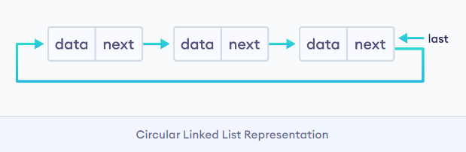
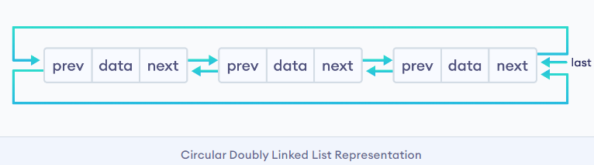
Circular linked list
A circular linked list can be implemented using both singly linked list and doubly linked list.

Slide 73
Circular Linked List
Advantages of a Circular linked list
Entire list can be traversed from any node.
Circular lists are the required data structure when we want a list to be accessed in a circle or loop.
Despite of being singly circular linked list we can easily traverse to its previous node, which is not possible in singly linked list.
Disadvantages of Circular linked list
Circular list are complex as compared to singly linked lists.
Reversing of circular list is a complex as compared to singly or doubly lists.
If not traversed carefully, then we could end up in an infinite loop.
Like singly and doubly lists circular linked list also doesn’t supports direct accessing of elements.

Slide 74
Basic Operation on Circular Linked List:
Insertion: we can insert an element at 3 different positions
Insertion at the beginning
Insertion at the end.
Insertion in-between nodes.
Deletion: we can delete an element in 3 ways:
node to be deleted is only one node
last node to be deleted
any other nodes to be deleted
Display: displaying the elements of the list

Slide 75
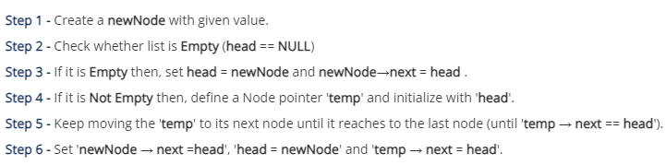
Insertion: Beginning of the list

Slide 76
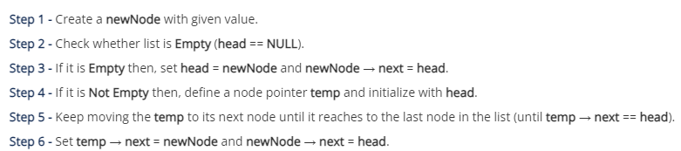
Insertion: At the end of the list

Slide 77
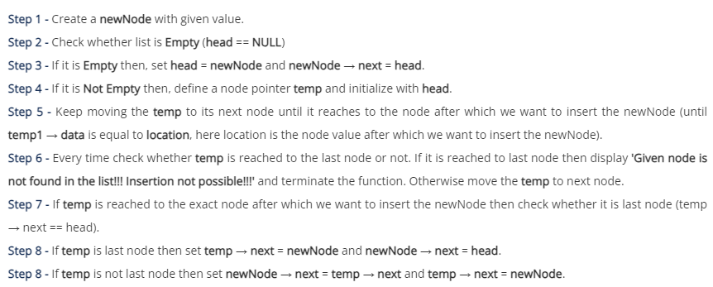
Insertion: At the Specific location

Slide 78
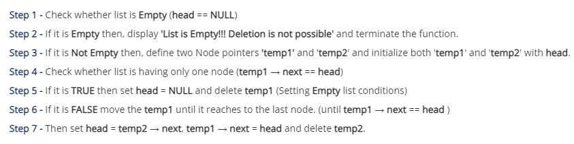
Deletion: From Beginning of the list

Slide 79
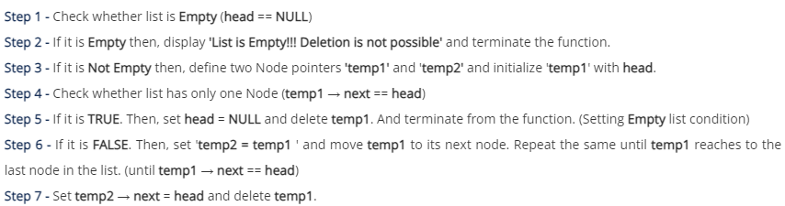
Deletion: From End of the list

Slide 80
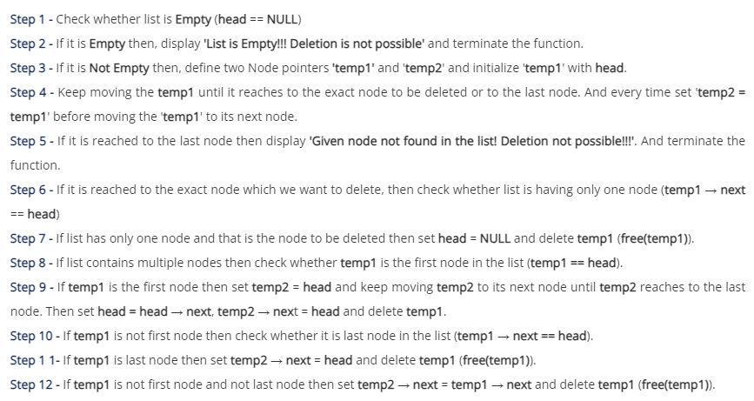
Deletion: Specific node of list

Slide 81
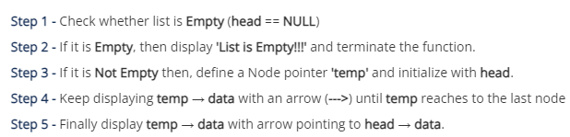
Displaying element of list

Slide 82
Stack as Linked List
The major problem with the stack implemented using an array is, it works only for fixed number of data values.
That means the amount of data must be specified at the beginning of the implementation itself.
Stack implemented using an array is not suitable, when we don’t know the size of data which we are going to use.
A stack data structure can be implemented by using a linked list data structure.
The stack implemented using linked list can work for an unlimited number of values. That means, stack implemented using linked list works for the variable size of data.
So, there is no need to fix the size at the beginning of the implementation.
The Stack implemented using linked list can organize as many data values as we want.

Slide 83
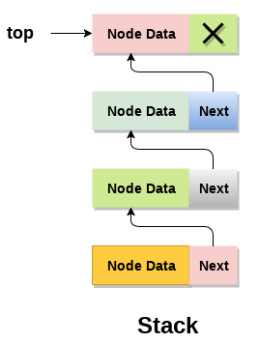
Stack as Linked List
In linked list implementation of a stack, every new element is inserted as ‘top’ element. That means every newly inserted element is pointed by ‘top’.
Whenever we want to remove an element from the stack, simply remove the node which is pointed by ‘top’ by moving ‘top’ to its previous node in the list. The next field of the first element must be always NULL.

Slide 84
Stack as Linked List
To implement a stack using a linked list, we need to set the following things before implementing actual operations:
Include all the header files which are used in the program. And declare all the user defined functions.
Define a ‘Node’ structure with two numbers data and next.
Define a Node pointer ‘top’ and set it to NULL.
Implement the main method by displaying Menu with list of operations and make suitable functions calls in the main method.

Slide 85
Stack as Linked List: Push Operation
Steps to insert a new node into the stack:
Create a newNode with given value.
Check whether stack is Empty (top = = NULL)
If it is Empty, then set newNode → next = NULL.
If it is Not Empty, then set newNode → next = top.
Finally, set top = newNode

Slide 86
Stack as Linked List: POP Operation
Steps to delete a node from the stack:
Check whether stack is Empty(top = = NULL).
If it is Empty, then display “Stack is Empty!!!” and terminate the function.
If it is Not Empty, then define a Node pointer ‘temp’ and set it to ‘top’.
Then set ‘top = top→ next’.
Finally, delete ‘temp’. (free(temp)).

Slide 87
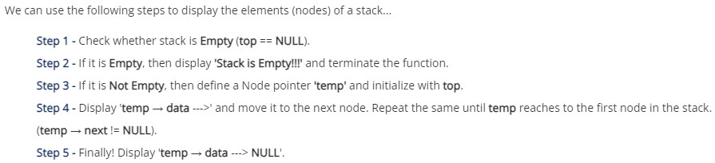
Stack as Linked List: Displaying elements

Slide 88
Queue as Linked List:
The major problem with the queue implemented using an array is, It will work for an only fixed number of data values.
That means, the amount of data must be specified at the beginning itself.
Queue using an array is not suitable when we don’t know the size of dta which we are going to use.
The queue which is implemented using a linked list can work for an unlimited number of values. That means, queue using linked list can work for the variable size of data (No need to fix the size at the beginning of the implementation).
The Queue implemented using linked list can organize as many data values as we want.

Slide 89

Queue as Linked List:
In linked list implementation of a queue, the last inserted node is always pointed by ‘rear’ and the first node is always pointed by ‘front’.

Slide 90
Operations:
To implement queue using linked list, we need to set the following things before implementing actual operations.
Step 1 - Include all the header files which are used in the program. And declare all the user defined functions.
Step 2 - Define a 'Node' structure with two members data and next.
Step 3 - Define two Node pointers 'front' and 'rear' and set both to NULL.
Step 4 - Implement the main method by displaying Menu of list of operations and make suitable function calls in the main method to perform user selected operation.

Slide 91
enqueue( ) Operation: Inserting an element into the queue
We can use the following steps to insert a new node into the queue...
Step 1 - Create a newNode with given value and set 'newNode → next' to NULL.
Step 2 - Check whether queue is Empty (rear == NULL)
Step 3 - If it is Empty then, set front = newNode and rear = newNode.
Step 4 - If it is Not Empty then, set rear → next = newNode and rear = newNode.

Slide 92
dequeue( ) operation: deleting an element from queue
We can use the following steps to delete a node from the queue...
Step 1 - Check whether queue is Empty (front == NULL).
Step 2 - If it is Empty, then display "Queue is Empty!!! Deletion is not possible!!!" and terminate from the function
Step 3 - If it is Not Empty then, define a Node pointer 'temp' and set it to 'front'.
Step 4 - Then set 'front = front → next' and delete 'temp' (free(temp)).

Slide 93
display( ) operation: displaying an element of an queue
We can use the following steps to display the elements (nodes) of a queue...
Step 1 - Check whether queue is Empty (front == NULL).
Step 2 - If it is Empty then, display 'Queue is Empty!!!' and terminate the function.
Step 3 - If it is Not Empty then, define a Node pointer 'temp' and initialize with front.
Step 4 - Display 'temp → data --->' and move it to the next node. Repeat the same until 'temp' reaches to 'rear' (temp → next != NULL).
Step 5 - Finally! Display 'temp → data ---> NULL'.

Slide 94
Any- Query??
The - End!

